Slide 1
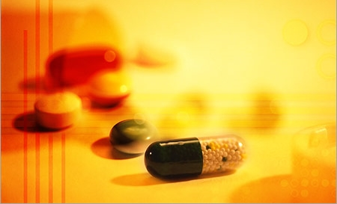
PROJECT BATCH – 5B
REVIEW - 1
MUKHEE JYOTHSNA
KORNU ASHOK KUMAR
3. PATHIVADA SAI JAHNAVI
4. SALLANGI NIKHILA
PROJECT SUPERVISOR
Dr . P . Srinivasa Rao
Associate Professor

Slide 2


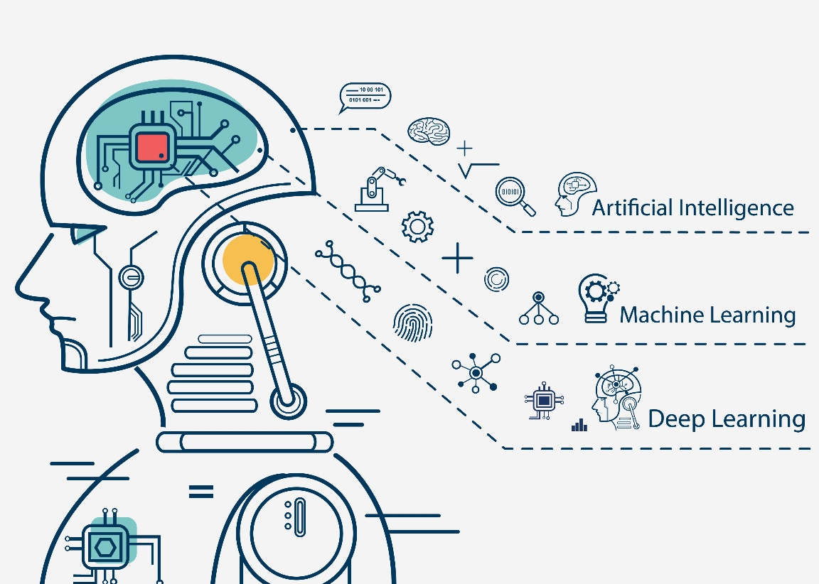
DRUG DISCOVERY (COMPOUND SIMILARITY PREDICTION)
Project Area : Machine Learning
Notes:
Jay

Slide 3
Literature survey
[1] Hakime Ozturk et al, explained an approach on offensive content clustering in compound similarity in Drug Discovery using Machine learning. the Information about the design and discovery of drugs with the column called SMILES. SMILES(Simplified Molecular Input Entry Specification) consists of all the chemical formula of each and every compound. In this agglomerative clustering, is used to combine the similar compounds. With this review, they have summarized the impact of NLP on bio/cheminformatics to encourage this already interdisciplinary field to take advantage of recent advances.
[2]Hakime Ozturk et al, Explained the study of SMILES-based Compound similarity functions for drug-target interaction prediction. Molecular structures can be represented as strings of special characters using SMILES. Since each molecule is represented as a string, the similarity between compounds can be computed using SMILES-based string similarity functions. Most previous studies on drug-target interaction prediction use 2D-based compound similarity kernels such as SIMCOMP.
[3]Martin Vogt et al,Described Python package for modelling Tanimoto similarity value distributions”. It described the information about how to use the ccbmlib Python package which is a collection of modules for modelling similarity value distributions. From this paper invoked that this is used to assess the statistical significance of Tanimoto coefficients and evaluate how molecular similarity is reflected when different fingerprint representations are used and conditional significance score to estimate where a test compound would be ranked in a search and the resulting models have been evaluated for RDKit fingerprints, taking a collection of ChEMBL compounds as a reference data set.

Slide 4
[4]B. Zagidullin et al,describes the Application of machine and deep learning methods in drug discovery and cancer research has gained a considerable amount of attention in the past years. As the field grows, it becomes crucial to systematically evaluate the performance of novel computational solutions in relation to established techniques. To this end, we compare rule-based and data-driven molecular representations in prediction of drug combination sensitivity and drug synergy scores using standardized results of 14 high-throughput screening studies, comprising 64 200 unique combinations of 4153 molecules tested in 112 cancer cell lines. We evaluate the clustering performance of molecular representations and quantify their similarity by adapting the Centered Kernel Alignment metric. Our work demonstrates that to identify an optimal molecular representation type, it is necessary to supplement quantitative benchmark results with qualitative considerations, such as model interpretability and robustness, which may vary between and throughout preclinical drug development projects. B. Zagidullin et al[4] compare rule-based and data-driven molecular representations in prediction of drug combination sensitivity and finding drugsynergy scores using standardized results and later on to evaluate the clustering performance of molecular representations and quantify their similarity by adapting the Centred Kernel Alignment metric (identify an optimal molecular representation type (CKA)).
[5]Daniel Probst et al,explained that MAP4 is a new molecular fingerprint suitable for drugs and can be adopted as a universal fingerprint to describe and search chemical space so here it takes MinHasing.
[6]Ravi Manne et al, examined machine learning and deep learning techniques which helppharma industry in all stages of drug discovery which includes target validation, prognostic bookmarks, technical traits, in which these are totally seven phases in the process of drug discovery

Slide 5
[7]Suresh Dara et al , Described the feasible literature on drug discovery through ML tools and techniques that are enforced in every phase of drug development to accelerate the research process. Target validation, prognostic biomarkers, digital pathology are considered as the problem statements where In clinical trials, absolute and methodological data must be generated to tackle many puzzles in validating ML techniques, improving decision-making, promoting awareness in ML approaches, and deducing risk failures in drug discovery.
[8]“Anaconda and Jupyter Note Setup” to install anaconda for my execution where, the Anaconda distribution includes the Conda package manager in addition to the preconfigured Python packages and other tools. Anaconda Navigator is a GUI tool that is included in the Anaconda distribution and makes it easy to configure, install, and launch tools such as Jupyter Notebook.

Slide 6
Problem Definition:
To identify the similar compounds among huge databases based on the chemical and biological properties and estimate the amount of drug we need to give to a person with certain conditions.
Algorithms used:
1) K-Means:
K-Means is a clustering algorithm in machine learning that can group an unlabeled dataset very quickly and efficiently in just a few iterations. It works by labelling all instances on the cluster with the closest centroid. When the instances are centered around a particular point, that point is called a centroid.
1) Calculate the mean value of each cluster, and use this mean value to represent the cluster;
2) Re-distribute the objects to the closest cluster according to its distance to the cluster center;

Slide 7
3) Update the mean value of the cluster, say, calculate the mean value of the objects in each cluster;
4) Calculate the criterion function E, until the criterion function converges.
Usually, the K-mean algorithm criterion function adopts square error criterion, defined as:
E = ∑_{i=0}^{k} ∑ _{p ∊Ci} | p - m_{i}|²
In which, E is total square error of all the objects in the data cluster, p is given data object, mi is mean value of cluster Ci (p and m are both multi dimensional).
2)Agglomerative hierarchical clustering :
The Agglomerative clustering is the most common type of hierarchical clustering used to group objects in clusters based on their similarity. The algorithm starts by treating each object as a singleton cluster. Next, pairs of clusters are successively merged until all clusters have been merged into one big cluster containing all objects.

Slide 8
Algorithm:
Begin initialize c, c1 = n, Di = {xi}, i = 1,…,n ‘
Do c1 = c1 – 1
Find nearest clusters, say, Di and Dj
Merge Di and Dj
Until c = c1
Return c clusters
End

Slide 9
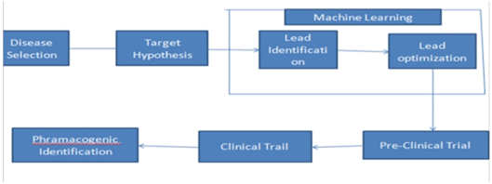
WORK FLOW

Slide 10
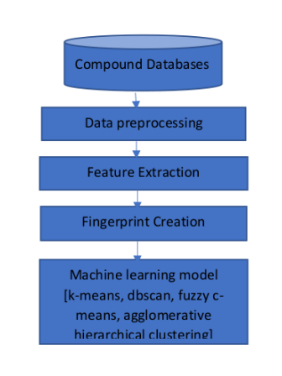
Flow Chart

Slide 11
1. Pre-Drug Discovery Process (Disease identification)
In this step we identify the disease based on the symptoms of disease.
2. Modern Drug Discovery Process:
The discovery process includes four important processes such as, target identification and validation, lead identification, lead optimization and pre-clinical trials.
a) Target Identification & Validation
Target identification is the process of identifying the direct molecular target for example protein or nucleic acid of a small molecule. In clinical pharmacology, target identification is aimed at finding the efficacy target of a drug/pharmaceutical or other xenobiotic. It used to identify target molecule which can be either gene or protein
b) Lead Identification
Lead identification also helps to see which molecules bind strongly to the target. Identifying the cellular and genetic factors involved in the disease, followed by the identification of potential targets.

Slide 12
c) Lead Optimization
This phase results in finding the drug candidate from the lead identified compound. The goal is a process of refining the chemical structure of a confirmed. Hit to improve its drug characteristics. The main aim of the lead optimization is to eliminate the side effects/notorious effects of the existing active analogues by a minimal structural modification to yield a better and safer scaffold.
d)Pre- Clinical Trial
an important phase to check whether the compound is working correctly or not
e) Clinical Trial
The compound that has showed some promising features in the last phase are then proceeded to clinical trials. In this phase the trials are being done on human volunteers .Primary base which will be fastest and safest way to find treatments.

Slide 13
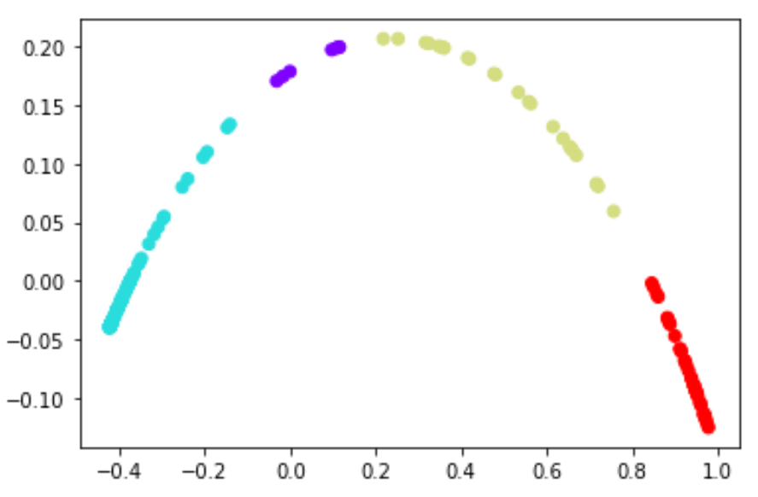
INPUT
MOLV3000 sdf file
Any no. of fingerprints to make clusters
OUTPUT
Density Based clustering

Slide 14
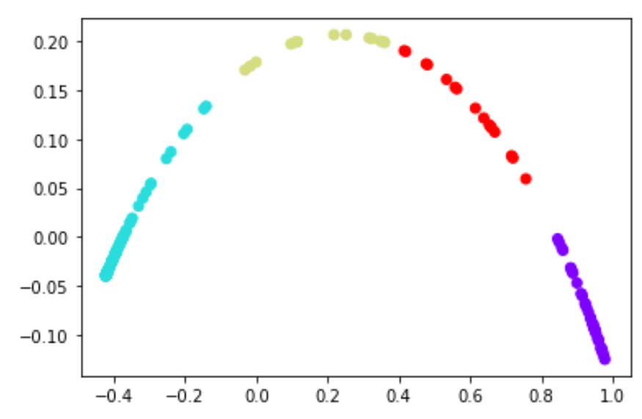
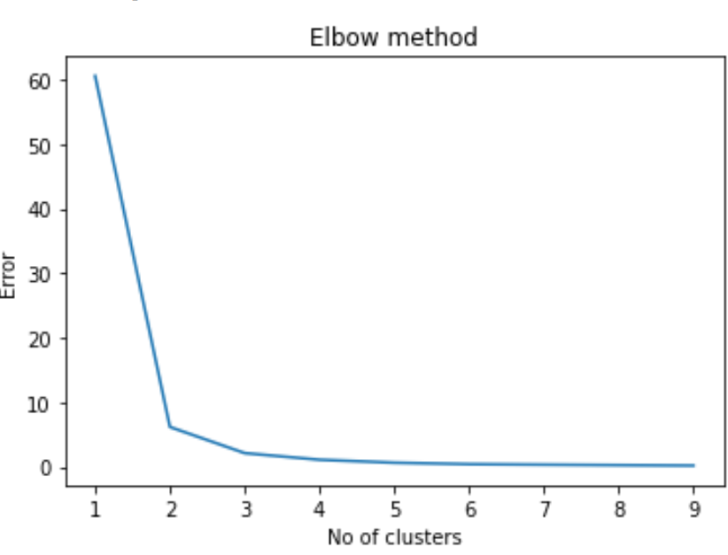
K means clustering
Elbow method

Slide 15

HARDWARE REQUIREMENTS AND SOFTWARE REQUIREMENTS
HARDWARE REQUIREMENTS:
PROCESSOR BASE FREQUENCY: 1.1 GHZ
RAM: 4 GB
HARD DISK: 1 TB
SOFTWARE REQUIREMENTS:
OPERATING SYSTEM: WINDOWS
LANGUAGE: PYTHON
TOOL: ANACONDA NAVIGATOR, JUPITER NOTEBOOK, GEPHI
DATABASE: MYSQL
BROWSER: CHROME, MOZILLA, OPERA ETC
TECHNOLOGIES: IMAGE PROCESSING, CONVOLUTIONAL NEURAL NETWORKS, DEEP LEARNING, MACHINE LEARNING.

